Slide 1


Improving Information Dissemination
Malcolm Hale:
Notes:
Note didn’t get permission for logo use.

Slide 2
Data Sets
NCANDS The National Child Abuse and Neglect Data System (NCANDS) is a voluntary data collection system that gathers information from all 50 states, the District of Columbia, and Puerto Rico about reports of child abuse and neglect.
AFCARS The Adoption and Foster Care Analysis and Reporting System (AFCARS) collects case-level information from state and tribal title IV-E agencies on all children in foster care and those who have been adopted with title IV-E agency involvement.
NYTD The National Youth in Transition Database (NYTD) is a federal reporting system designed to collect information on youth transitioning out of foster care who are served by state agencies
Notes:
Child abuse and neglect
Fostercare
Adoption
Transitioning out of fostercare
These files are clean up to a point.

Slide 3
Problem
We produce very limited number of reports. They are all at a super high level (national and state only) and currently focus on one of two things
Providing summary statistics
Compliance reports
General Reaction: ¯\_(ツ)_/¯
Of limited use to state technical liaisons whose job it is to work with the state to provide TA, and help with compliance issues
Of limited use to leadership make informed decision
Notes:
Summary reports are frequencies and crosstabs of the by state/year.
Entries, exits, # waiting to be adopted, # adopted
Types of maltreatment, demographics of children, demographics of perpetators.
Compliance Reports has a lot of extra steps in their creation but still ultimamtely come down to reports at the state level.
(Someone thought it would be a good idea to have each state risk-adjusted using a multilevel model)
Exampe of telling a state that they have failed a measure, but not telling them anything more.
Most states have been forced to cut their own research/data staff due to budget cuts.

Slide 4
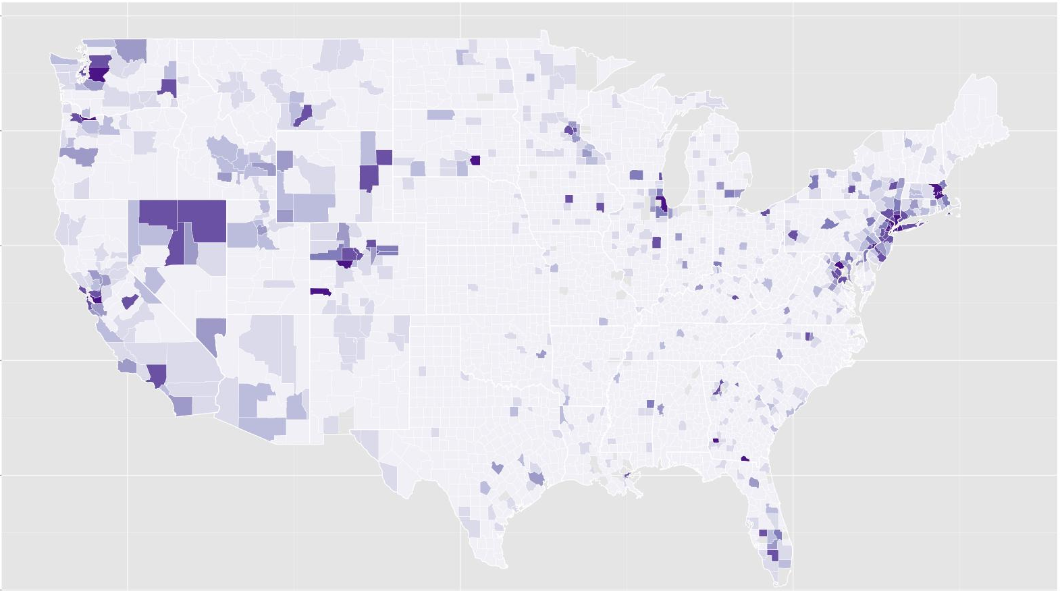
Solution
A flexible dashboard that could take different datasets and produce informative graphics
Initial focus will be on producing choropleth maps at the county level. While the data is submitted to us by each state, each state is usually pulling this data from offices found within each county (or similar).
Would like to expand to other visualizations to include relevant graphs and charts as needed.
Notes:
No learning/unsupervised learning methods to be used here.

Slide 5
Measures
Focusing in order of impact
Compliance measures
2) Data quality issues
3) Common measures
Foster care entry and exit rates
Recurrence of maltreatment

Slide 6

Challenges
Data is restricted use, will have to create fake but realistic data for the Colab.
Notes:
Fake data – due to the sensitive nature of the age of the children and their circumstances
Scope Creep and Time limitation

Slide 7
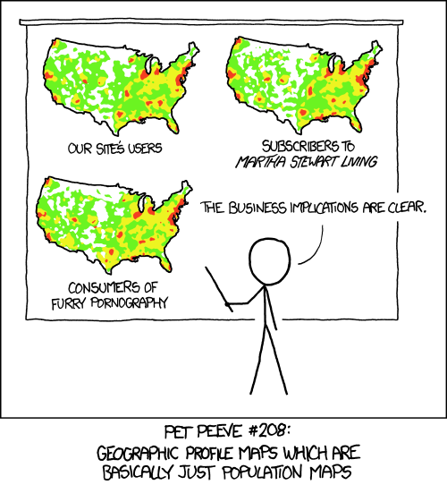
Challenges
Making sure the choropleth maps actually provide useful information
Datasets get large depending on number of years included

Slide 8
Work Flow
Task 1. Data
Create fake version of dataset
Verify dataset is roughly correct
Import into R
Merge dataset with geographic data (shape file)
Task 2. Geographic Stuff
Obtain US County Shape File
Obtain Additional Geographic regions
Task 3. Choropleth Visualization
Create initial choropleth maps
Add additional measures
Filters
Drop down selections
Drill down
Task 4. Additional visualizations
Charts (over time)
Tables
 | Begin | End
Sprint 1. | Week 2 | Week 4
Create fake version of dataset
Verify dataset is roughly correct
Import into R
Obtain US county shape file
Merge dataset with geographic data (shape file)
Sprint 2. | Week 5 | Week 5
Create initial choropleth maps
Drop down selections
Drill down
Sprint 3. | Week 6
?
?
?

